Slide 1
What We’ll Cover Today ?
What is React & Why use it?
React Features & Virtual DOM
Setting up your first React project
Project structure walkthrough
JSX fundamentals
Components & Props

Slide 2
What is React ?
What is React? An open-source, front-end JavaScript library created by Meta.
Primary Purpose: Building dynamic, interactive user interfaces for single-page applications (SPAs).
Core Paradigm: Enables developers to build reusable UI components that manage their own state.

Slide 3
Why React?
High Performance: Lightning-fast rendering via the Virtual DOM and efficient diffing.
High Reusability: Write code once, use it across different app sections or projects.
Strong Ecosystem: Backed by Meta and a massive community with a rich library ecosystem.
Unidirectional Data Flow: Predictable data movement downward from parent to child.

Slide 4
React Core Features
JSX: Write HTML structures directly inside JavaScript files.
Components: Modular building blocks for user interfaces.
Props: Mechanism for passing data downstream from parent to child.
State & Hooks: Built-in tools (useState, useEffect) to manage dynamic data and lifecycle events.

Slide 5
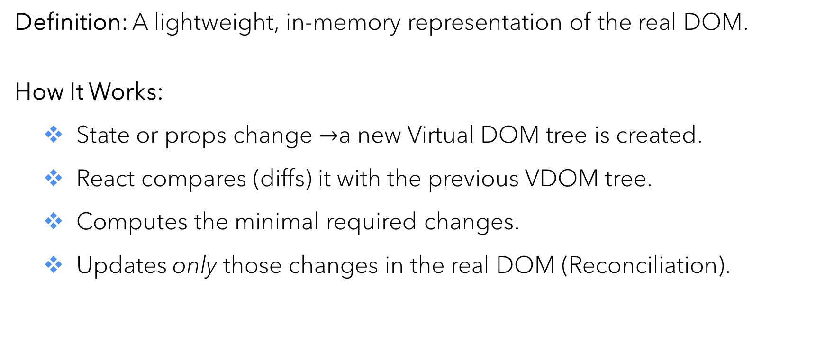
Virtual DOM
Definition: A lightweight, in-memory representation of the real DOM.
How It Works:
State or props change $→$a new Virtual DOM tree is created.
React compares (diffs) it with the previous VDOM tree.
Computes the minimal required changes.
Updates only those changes in the real DOM (Reconciliation).

Slide 6
Create First React Project
Tooling: Scaffold modern apps quickly using Vite.
Setup Commands:
npm create vite@latest // Choose the configurations as per your convenience
cd my-react-app
npm install
npm run dev

Slide 7
Understand Project Structure
node_modules/ : Project dependencies and packages.
public/ : Static assets and images.
src/ : Core source files (App.jsx, main.jsx, CSS styles).
package.json : Project metadata, scripts, and dependency list.

Slide 8
JSX (JavaScript XML)
Definition : Syntax extension allowing HTML-like markup inside JavaScript files.
Key Rules :
Must have a single root element (or fragment <>...</>).
All tags must be closed (e.g., <img />).
Attributes use camelCase (e.g., className, onClick).
Embed expressions using curly braces {}.

Slide 9
Components
What are they ? Independent, reusable building blocks of user interfaces.
Functional Components : JavaScript functions that accept inputs and return JSX elements.
Encapsulation : Work in isolation to keep code organized, clean, and maintainable.

Slide 10
Props (Properties)
Purpose: Arguments passed into React components to pass data from parent to child.
Key Rule: Props are read-only (immutable) from the perspective of the receiving child component.
Usage: Enables dynamic, reusable component templates (e.g., <UserProfile username="Alice"/>).

